Slide 1


Session 1
The Foundation
& Positioning
Building Your Breakthrough Voice
Ananya Narang | Founder, Entourage

Slide 2
Course Introduction
Building Your Breakthrough Voice
By the end of this course, you will have a live, functioning LinkedIn personal brand that turns your real Mesa work into public proof of work.
Three defined content pillars
A fully optimized, conversion-ready profile
Structured content the algorithm carries to the right audience
A daily engagement habit
Warm-outreach skills that earn replies
An inbound engine that makes opportunity come to you

Slide 3

Objective of the Day
Success of this class is measured when you would be able to:
1
Draft and publish a LinkedIn post immediately after class
2
Articulate 3 content pillars a peer can accurately read back to you
3
Have a fully optimized profile: banner, headline, About, and Experience sections all complete
4
Understand why LinkedIn distributes by relevance and can define personal branding as making competence legible

Slide 4

Opening: The Premise
Quick round:
1
Who posts on LinkedIn?
2
Who only scrolls?
3
Who has never posted?
You are all sitting on real proof of work already: live projects, sales, research. The only question is whether the right people can see it. That is what a personal brand does.

Slide 5
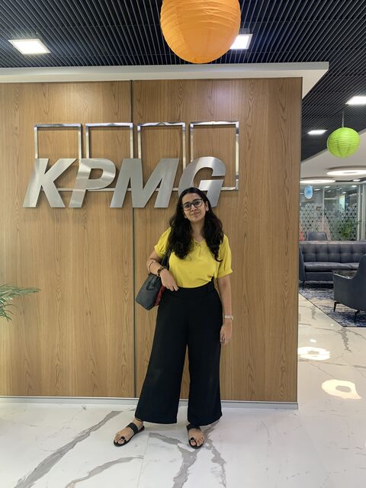
My Story: How LinkedIn Changed Everything
Here’s my journey a little over a year before Entourage.
What changed my trajectory was writing in public, consistently, about content, branding, and building.
That body of work compounded into 50,000+ followers, and far more importantly, inbound. Founders reached out. Opportunities she never applied for started arriving.
Entourage exists because a personal brand turned me from someone looking for opportunities into someone opportunities looked for.
The point is what the platform does when you show up with a clear, consistent voice.

Slide 6
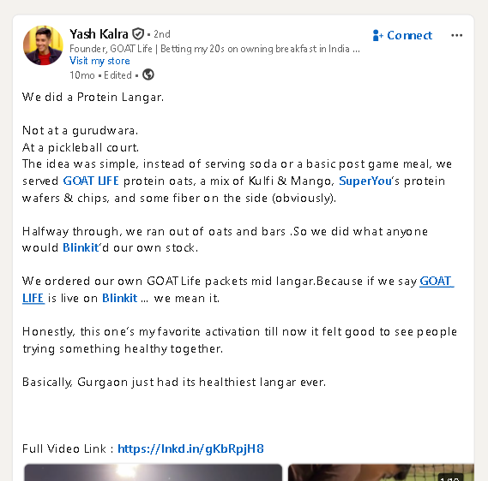
Builders Closer to Your Starting Line
Yash Kalra
GOAT Life | Age 26 | From Kota
Built attention with honesty, walked into Shark Tank with no theatrics and just his real story.
Posts like a real person figuring it out in public. His line: coming from a small city is your grit and story, things no metro can replicate.
Proof that polish is optional when authenticity is present and consistent.
Link to the profile

Slide 7
The Common Thread
None of them won on biggest network or slickest content.
They won by making real work and real thinking visible, consistently, to the right people.
You have more raw material than most of them started with.
The whole game is making it visible.

Slide 8
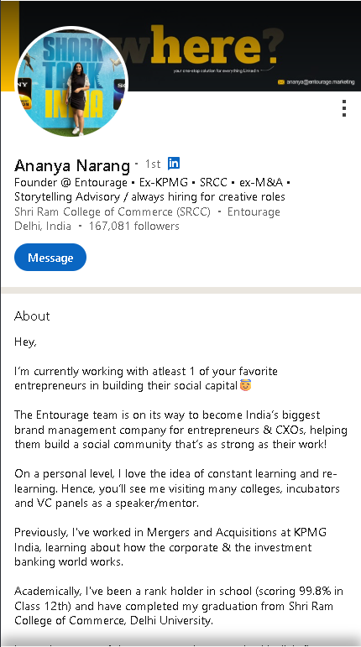
Live Profile Optimization
LIVE IN-CLASS BUILD
Use a strong reference profile (e.g. Search Ananya Narang on LinkedIn) and build your own version of each element in real time.
1
Banner
Your billboard. State your value in a glance.
2
Headline
The highest-leverage 220 characters you own.
3
About
Hook > Value > Proof > Human > Invitation.
4
Education & Experience
Proof surfaces, rewritten as outcomes.

Slide 9
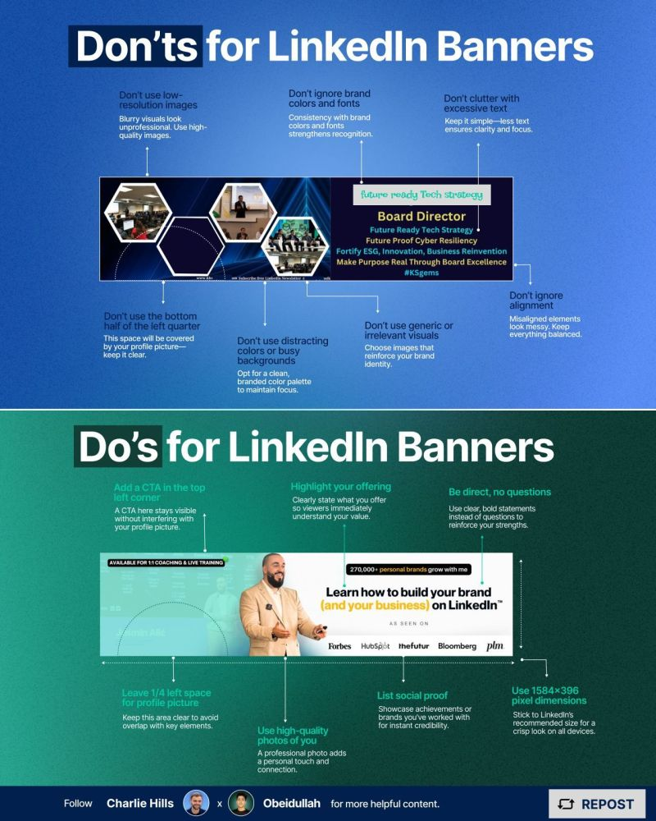
Element 1: The Banner
90% leave the default blue. That is a wasted billboard.
One job: state your value in a glance.
ACTION: Draft your banner line now
"Building in public at Mesa + [your domain]"
Build it in Canva. Live. Right now.

Slide 10
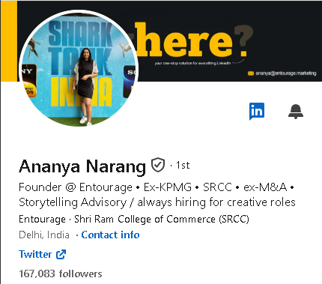
Element 2: The Headline
The highest-leverage 220 characters you own. It follows you everywhere.
Kill the job-title default.
THE FORMULA
Role / Trajectory
+ Topics You Own
+ A Credibility Marker

Slide 11
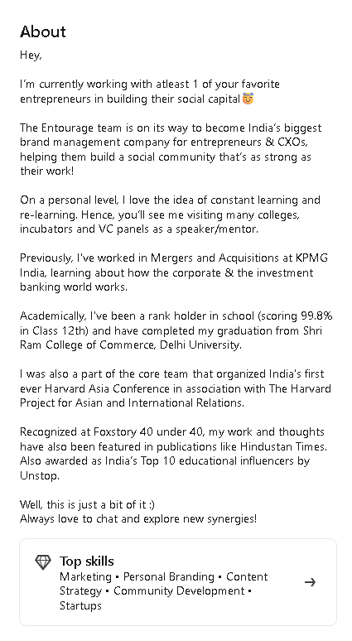
Element 3: The About Section
Reads like a real person talking to one reader.
1
Hook
Open with something that makes one reader stay
2
What You Do + Who You Help
Name the reader's problem in their language
3
Proof
Specific numbers, live projects, real results
4
A Bit of Human
Something personal that makes you memorable
5
Low-Friction Invitation
Make it easy for the reader to reach out

Slide 12
Element 4: Education & Experience
Proof surfaces but make sure it doesn’t become a data dump.
BEFORE
AFTER
"Responsible for market research"
>>>
"Led consumer research across 100 interviews to build a 24-month roadmap"
ACTION: Rewrite one line together. Apply to your Mesa projects.

Slide 13
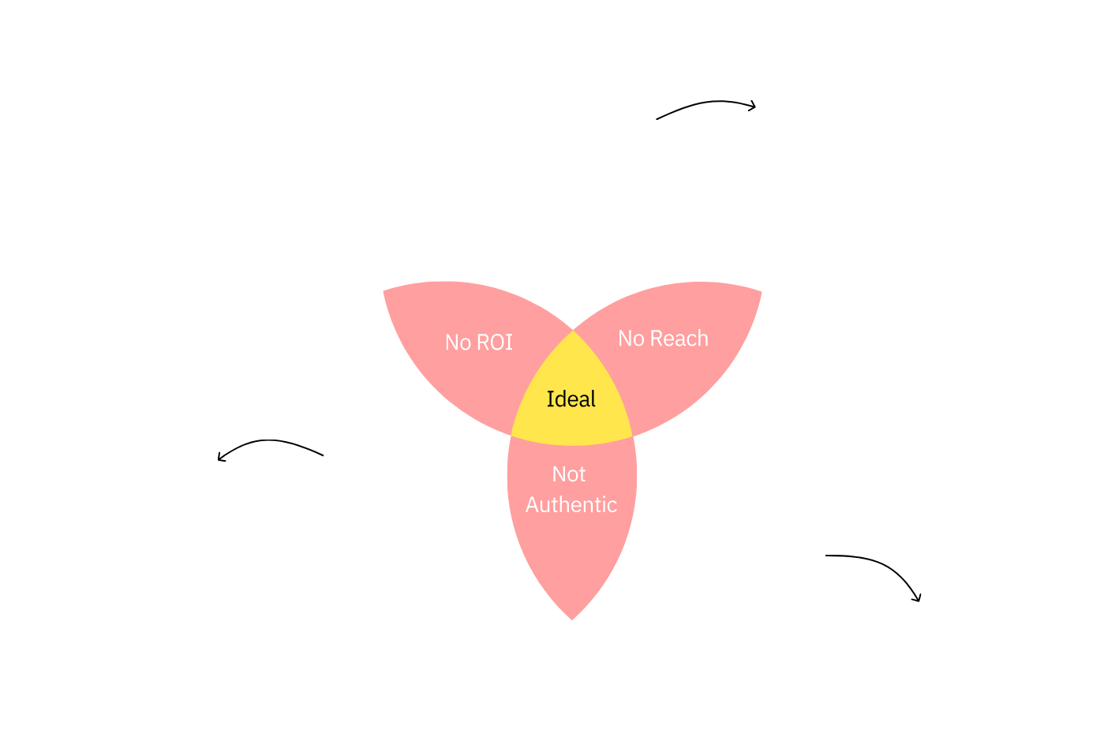
Positioning: The Architecture of Everything
The single biggest predictor of distribution is topic clarity. LinkedIn is always asking: what is this person about? The faster it answers, the more it distributes you.
Camp in one circle and you read like a diary, a brochure, or a trend-chaser.
The magic is the middle.

Slide 14
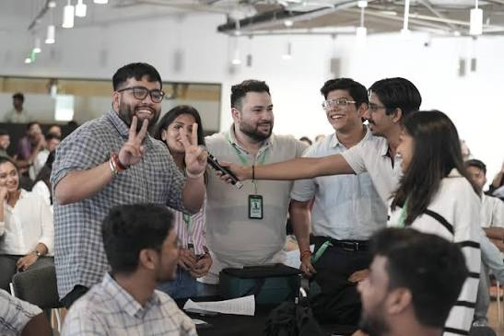
LinkedIn Networking Strategy
Build a relevant network. Connect with quality people in your target ecosystem rather than adding random connections that dilute your profile.
WHO TO CONNECT WITH:
Mesa alumni and faculty
Founders in your target industry
Recruiters at companies you aspire to join
Professionals from companies in your ecosystem
Event collaborators and higher-studies contacts

Slide 15
Showcase of Learning
ACTIVITY: PILLAR DRAFT
1
Draft your 3 content pillars. State each as: "I help [audience] understand [topic] through [my angle/proof]."
2
Pitch your pillars to 3 partners who read them back to you.
3
Rewrite until a stranger can repeat them accurately.
4
Also do a self-audit: how has your LinkedIn journey been so far, and why have you not fully tried to use it well until now?
The test is passed when a peer, shown only the ideas, names the same 2 pillars the student intended.

Slide 16
Friday Post: Week 1
OPTION A
OPTION B
The Origin Post
The "Why I Ignored LinkedIn" Post
A "why I'm here" introduction. Your pillars and what you're building at Mesa.
Hook idea: a specific, slightly counterintuitive line about your journey.
Honestly share why you never used the platform well until now, and what changed.
Self-aware and relatable, it plants your flag.
Pick one. Ship it this Friday.
Another one. Ship next week.

Slide 17
Graded Target: A1 - Profile + Network
Due by Session 2 | Weight: 25%
Optimize LinkedIn end-to-end: headshot DP, neat banner, actionable About, Featured section with achievements.
Send invites to grow your network. Build a relevant network by reaching out to Mesa alumni, faculty, founders, recruiters, and professionals from target companies.
PASSING FLOOR: 500+ connections (LinkedIn shows the clean '500+' badge, which reads as an established, credible profile). The first 500 are achievable from scratch with strategic outreach.
Friday posts x2:
Engagement: 30%
Quality of the post:70%
SUCCESS METRIC: Can every student draft and publish a post immediately, and articulate 3 pillars a peer can repeat?

Slide 18
Before Next Class
1
Finish the profile
Complete the About using the hook-value-proof-human-invitation arc. Rewrite your top two Experience lines as outcomes.
2
Complete your positioning Venn
Three honest pointers per circle, and the one-line positioning in the middle.
3
Publish ONE Friday post
Option A or B. Begin the daily habit: 5 substantive comments a day in your topic cluster.
4
Bring five on-pillar content ideas
These will fuel your work in Session 2.

Slide 19
One thing to remember:
You are not learning to post.
You are building the distribution
engine for your career.
Belief, then build, then position.

